Slide 1
Native American Families
Student Name
Institution Affiliation

Slide 2
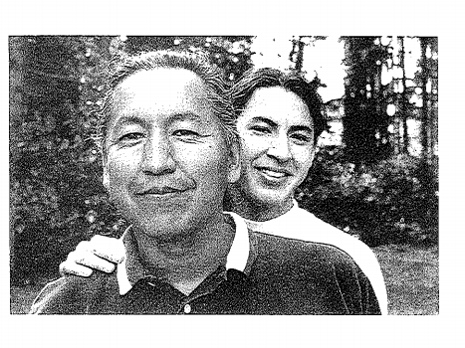
Introduction
Native Americans represent the smallest racial ethnic group
High rate of interracial marriages render native Americans invisible
Native Americans are indigenous to Americas
Native American population has dramatically increased since world war II
Notes:
Native Americans remain to represent the smallest ethnic group in America, although their population has increased over the decades. Over the year, the native Americans have intermarried with other races making them more visible. The native Americans' resided botch in the north and South America for centuries. However, after the coming of the Europeans, most of the Native Americans migrated to South America, forming different groups of citizens. The Europeans made the native Americans learn about different cultures, religions, and forms of government that shaped them to a greater extend. There has been a noticeable increase in the Native American population since World War II. The tribal affiliations have much contributed to the increase in the population Coles, 2016).

Slide 3
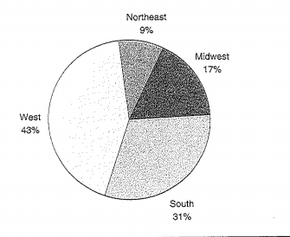
History
Native American have involuntarily incorporated in U.S
Native Americas have experienced severe discrimination
They faced forced acculturation
Negatively impacted by infamous policies
Notes:
The native Americans have involuntarily incorporated in the United States, just like Black Americans. They have been facing different forms of discrimination since they are one of the minority race. Additionally, the European colonization exposed them to more harm. European settlement exposed the Native Americans to forced acculturation and also displaced most of them. Additionally, the different ways of governance that was provided by the Europeans much impacted the Native Americans negatively. The policies, especially those related to ways of governance, rendered the local leadership in the Native American communities powerless Coles, 2016).

Slide 4
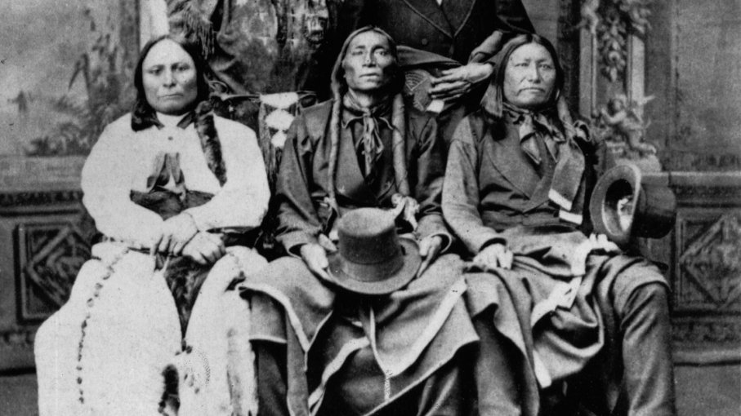
Assimilation of Native Americans
Supply education Act reduced the decline of Native Americans
Native Americans Children started receiving education
The missionary school supported education
The US government become more directly involved in school system
Notes:
In the past, there the native American families were facing a stiff decline. However, after the congress passed the supply education Act in 1819, the Native Americans started being assimilated. Their children started receiving education from schools. The few missionary schools that existed then much-supported education and allowed the Native American children to interact with others. As years progressed, the US government become more directly involved in the school system hence allowing all tribes to acquire education equally. Therefore, education much contributed to the assimilation of the Native Americans Coles, 2016).

Slide 5
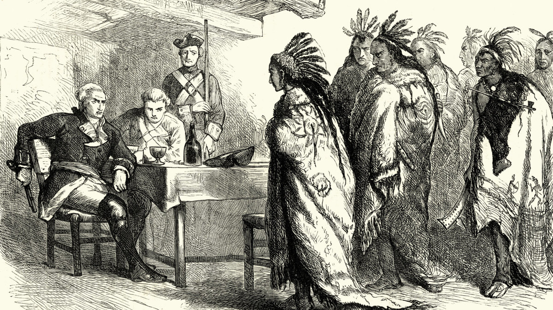
Increased Tribal Sovereignty
Soft approach to Native Americans after American Indian Movement
Laws increasing tribal controls
Dual citizenship of Native Americans
Federal and state governments control over resources
Notes:
The US government has been softer to the Native Americans after the hard times they encountered during the American Indian Movement. Different laws have been enacted to prevent any form of discrimination and to support the minority traces such as the Native Americans. Most of the celebrated laws include the self discrimination and education and assistance act and the education amendment act. Additionally, the exposure gave the Native Americans the United States citizenship hence making the citizens of both the US and their tribes. Additionally, Native Americans are able to access necessary resources such as food and water since the resource is now well used and some even reserved under the control of Federal and the States governments Coles, 2016).

Slide 6
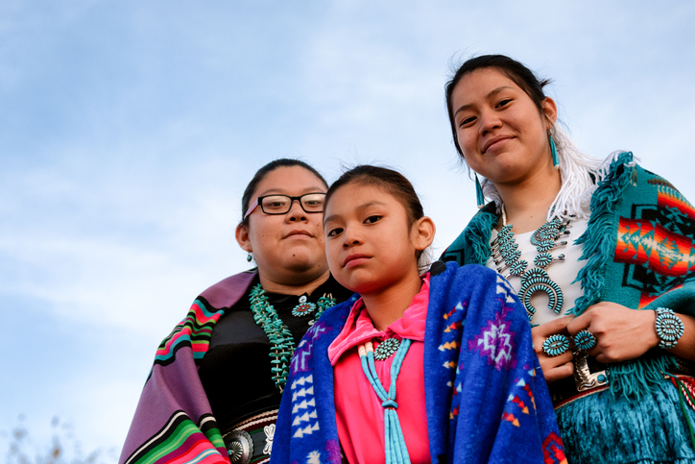
The state of American Indians and Their Families Today
On or Off the reservations
Tribal structure
Cultural Values
Netter family trends
Notes:
The government control over the reservations makes only 22% of the American Indians to currently be living in the reserved with other 25% living near these reserves. The native Americans are now allowed to access some of the reserves to get necessities. The tribes are still united by common governance and language. The clan bonds define better leadership within the Native Americans hence the continued existence. The native Americans have learned different cultural values, which have made their ways of living more better. Gifts and celebrations make them well known and easily traceable. Currently, Native American families are known to live as extended families. They are able to separate the family members from the non-family members. On the other hand, American Indian families are patrilineal and patriarchal (Coles, 2016).

Slide 7
Reference
Coles, R. L. (2016). Race and family: A structural approach. Rowman & Littlefield.

